Slide 1
Лекц 11. Hosting & Data Center
Интернэт технологийн үндэс
2024 он

Slide 2
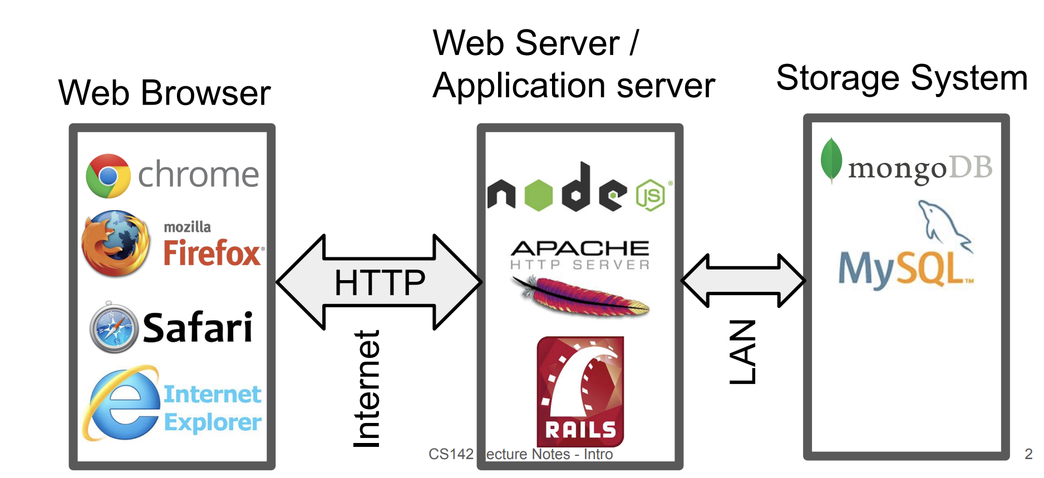
Web Server Structure

Slide 3
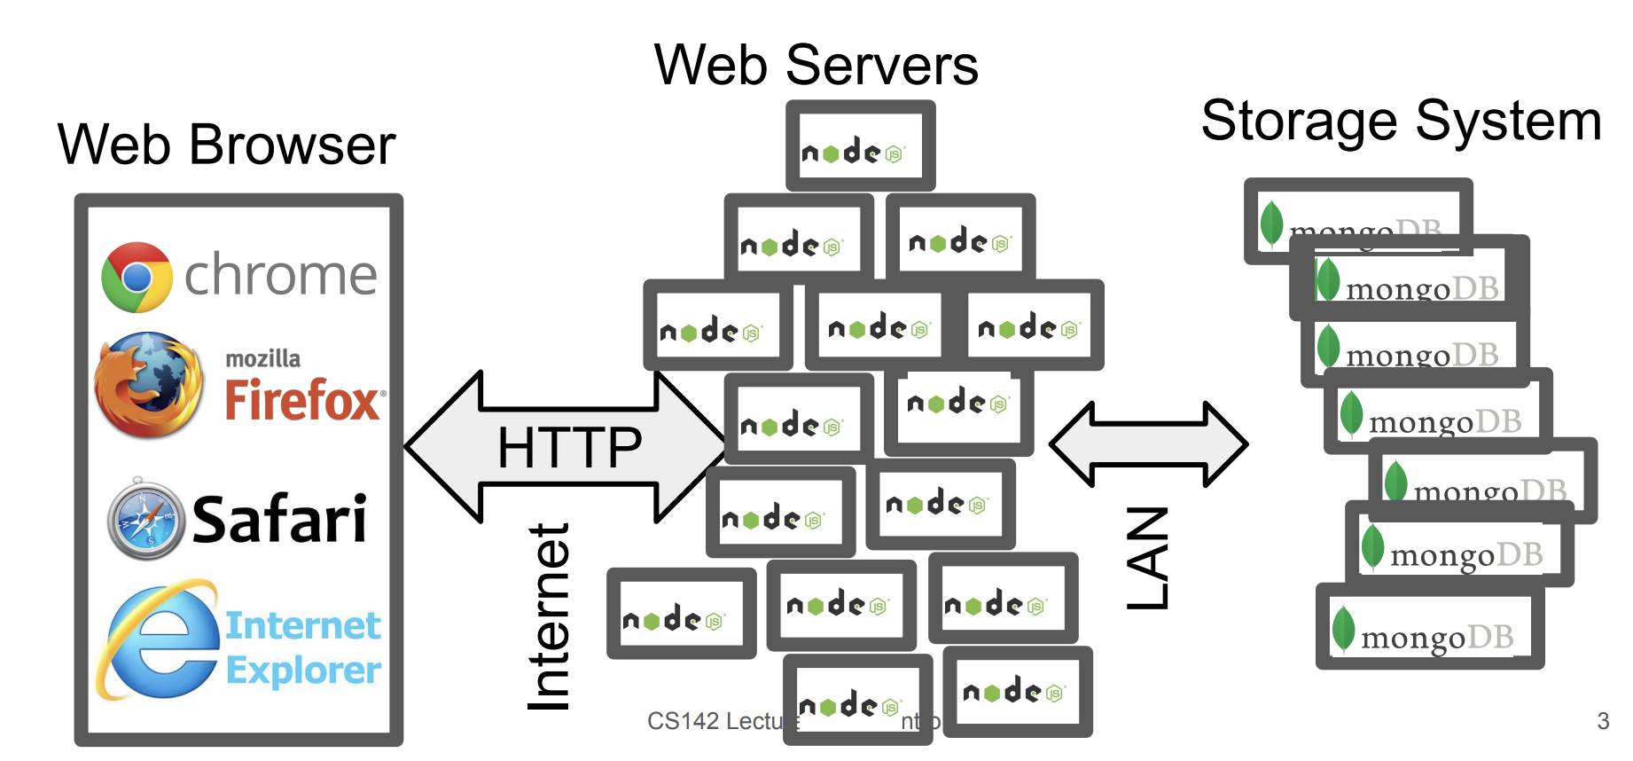
Large Scale Web Server Structure

Slide 4
Вэб сервэр гэж юу билээ?
Олон вэб хуудсуудын нэгдлийг вэб сайт гэж нэрлэнэ.
Бусдад вэб хуудсуудаа үзүүлэхийг хүсвэл өөрийн вэб сайтыг нийтлэх(publish) хэрэгтэй.
Вэб хуудсаа нийтлэхийн (publish) тулд вэб сервер лүү сайтыг хуулах хэрэгтэй.
Хэрвээ өөрийн PC static (dedicated) IP хаягтай сүлжээнд холбогдсон бол вэб сервер болгон ашиглаж болно.
Ерөнхийдөө ихэвчлэн Интернэтийн үйлчилгээ үзүүлэгч(ISP) компани ашиглан вэб хуудсаа серверт байрлуулдаг.

Slide 5
Types of Web Hosting
Web Hosting is the service that makes your website available to be viewed by others on the internet. A web host provides space on it’s server, so that computers around the world can access to your website by means of a network. There are couple of types of hosting.
Self-Hosting
Shared Hosting
Dedicated Hosting
Collocated Hosting
Cloud …

Slide 6
Self & Collocated Hosting
Холболтын нэр | Холболт | 1 секунд дэх хурд
Modem | Аналог | 14.4-56Kb
D0 | Тоон систем (ISDN) | 64Kb
T1 | Тоон систем | 1.55Mb
T3 | Тоон систем | 43Mb
OC-1 | Шилэн кабель | 52Mb
OC-3 | Шилэн кабель | 156Mb
OC-12 | Шилэн кабель | 622Mb
OC-24 | Шилэн кабель | 1.244Gb
OC-48 | Шилэн кабель | 2.488Gb
What we require
24/7 Internet
Static IP
Server Softwares
Lot of knowledge

Slide 7
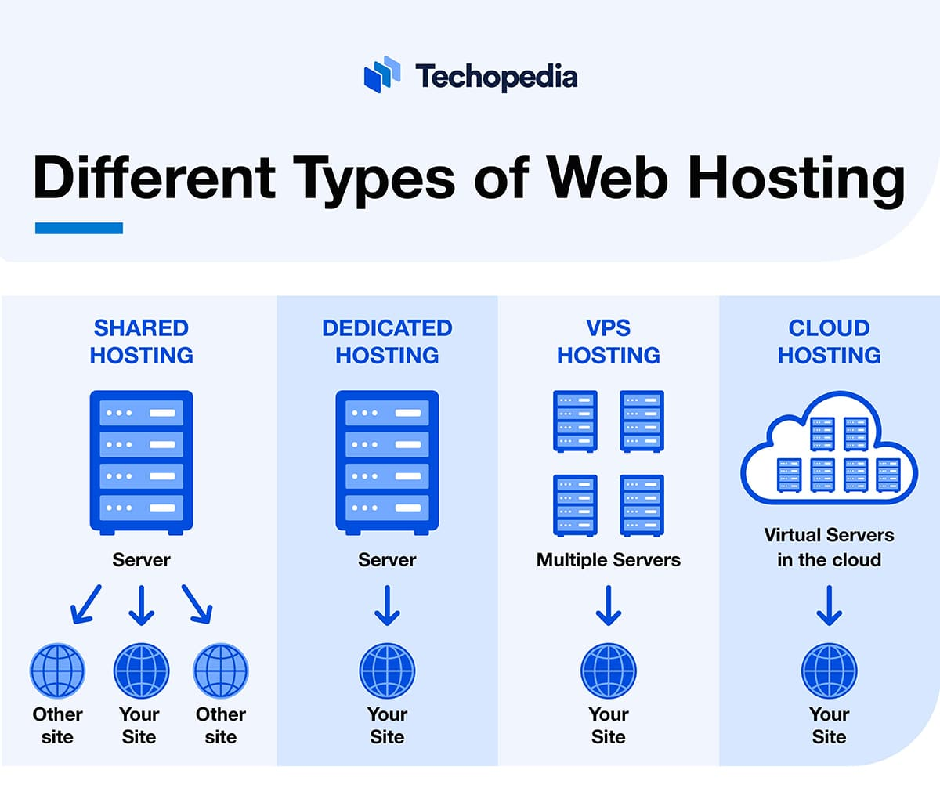
Other Hosting
Shared
Dedicated
VPS
Cloud
Amazon AWS
Google Cloud
MS Azure
…

Slide 8
Which server do you use?
Browsers want to speak HTTP to a web server - TCP/IP connect
Use load balancing to distribute incoming HTTP requests across many front-end web servers
HTTP redirection (e.g. HotMail):
Front-end machine accepts initial connections
Redirects them among an array of back-end machines
DNS (Domain Name System) load balancing:
Specify multiple targets for a given name
Handles geographically distributed system
DNS servers rotate among those targets

Slide 9
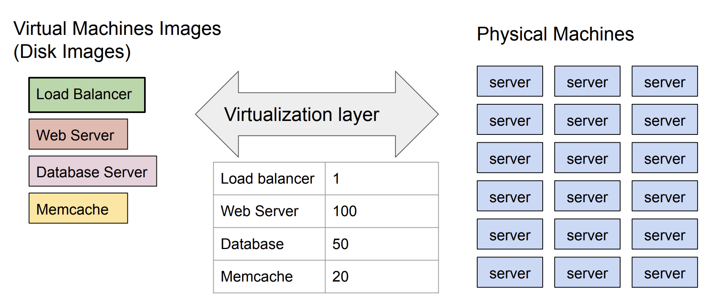
Virtualization - Virtual and Physical machines

Slide 10
Content Distribution Network (CDN)
Consider a read-only part of our web app (e.g. image, React JavaScript, etc.)
Browser needs to fetch but doesn't care where it comes from
Content distribution network
Has many servers positions all over the world
You give them some content (e.g. image) and they give you an URL
You put that URL in your app (e.g. <img src="...)
When user's browsers access that URL they are sent to the closest server (DNS trick)
Benefits:
Faster serving of app contents
Reduce load on web app backend
Only works on content that doesn't need to change often

Slide 11
Лекц 12. Data Center
Интернэт технологийн үндэс
2024 он

Slide 12
Evolution of data centers
1960's, 1970's: a few very large time-shared computers
1980's, 1990's: heterogeneous collection of lots of smaller machines.
Today and into the future:
Data centers contain large numbers of nearly identical machines
Geographically spread around the world
Individual applications can use thousands of machines simultaneously
Companies consider data center technology a trade-secret
Limited public discussion of the state of the art from industry leaders

Slide 13
Typical specs for a data center today
15-40 megawatts power (Limiting factor)
50,000-200,000 servers
$1B construction cost
Onsite staff (security, administration): 15

Slide 14
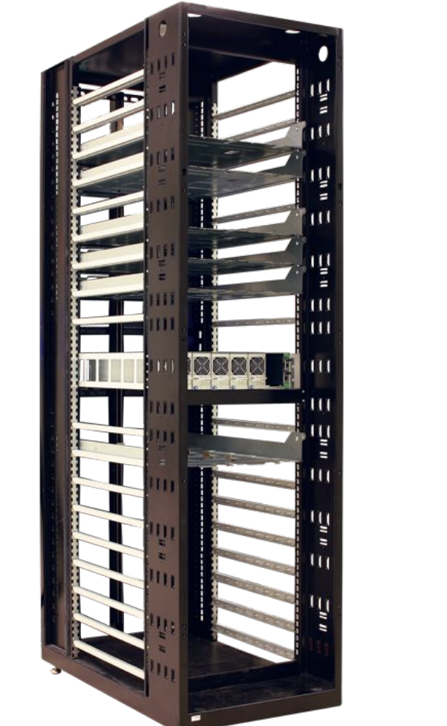
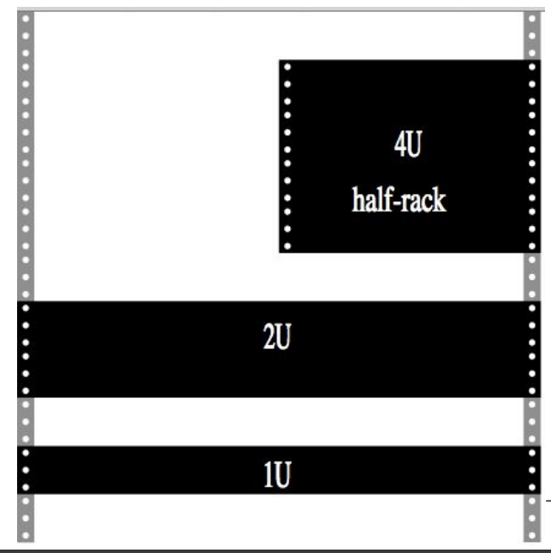
Rack
Typically is 19 or 23 inches wide
Typically 42 U
U is a Rack Unit - 1.75 inches

Slide 15
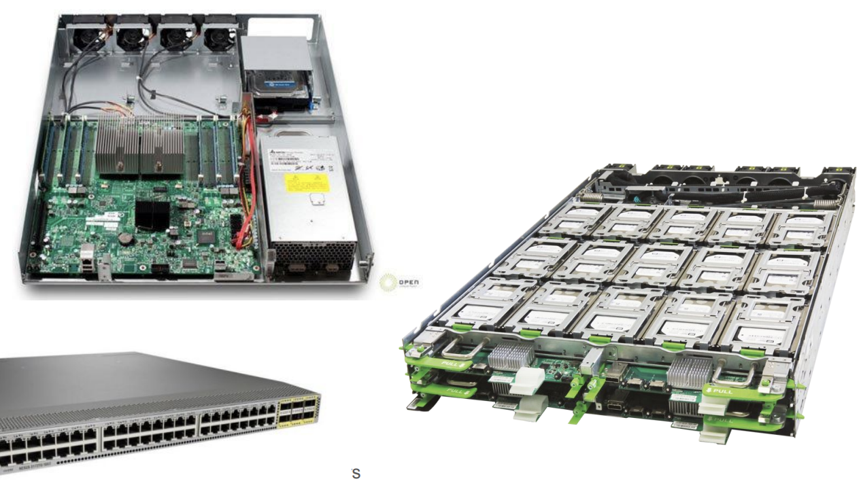
Rock Slots
Slots hold power distribution, servers, storage, networking equipment
Typical server: 2U
8-128 cores
DRAM: 32-512 GB
Typical storage: 2U
30 drives
Typical Network: 1U
72 10GB

Slide 16
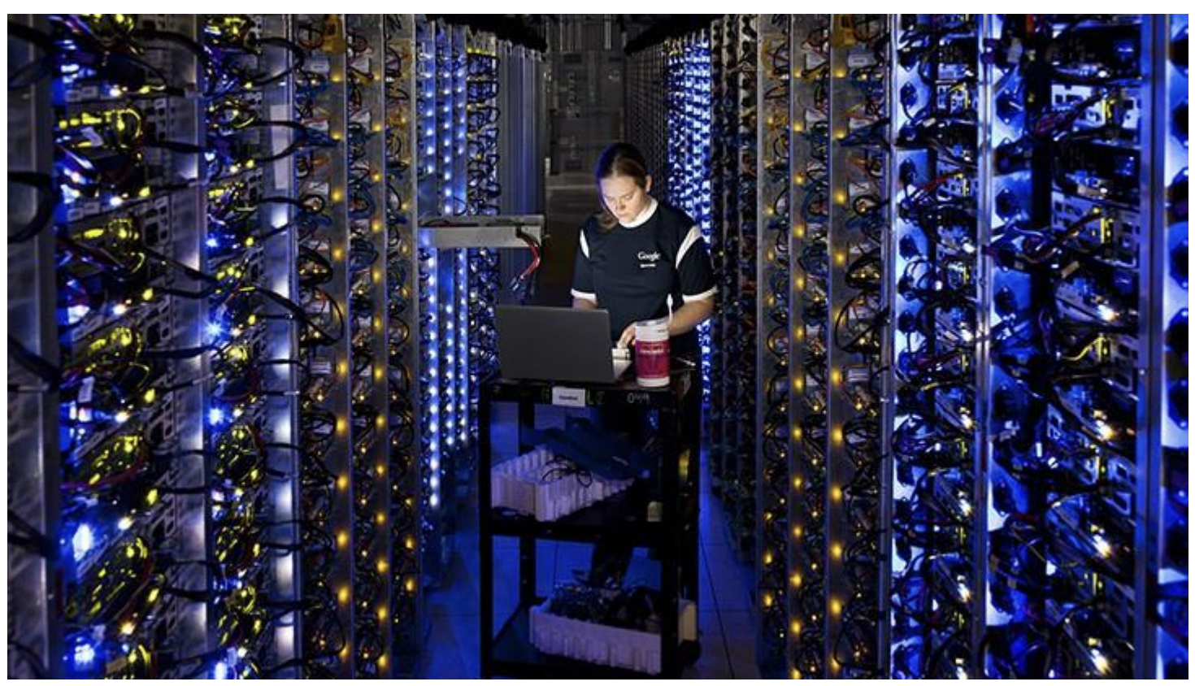
Row/Cluster
30+ racks

Slide 17
Networking - Switch locations
Top-of-rack switch
Effectively a cross-bar connecting machines in rack
Multiple links going to end-of-row routers
End-of-row router
Aggregate row of machines
Multiple links going to core routers
Core router
Multiple core routers

Slide 18
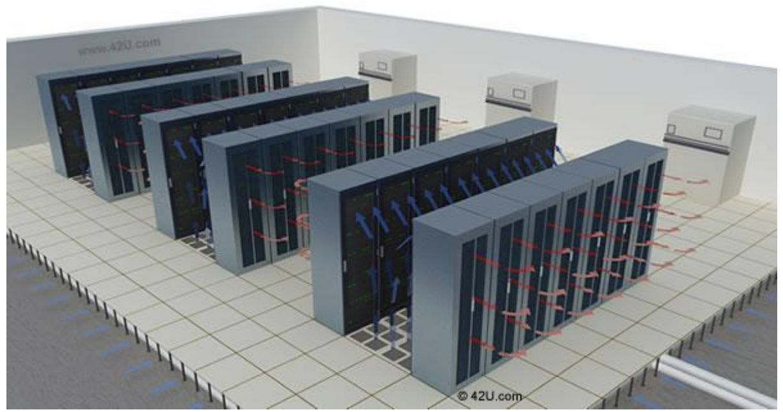
Energy Efficient Data Centers
Better power distribution - Fewer transformers ● Better cooling - use environment (air/water) rather than air conditioning ○ Bring in outside air ○ Evaporate some water ● Hot/Cold Aisles: ● IT Equipment range ○ OK to +115℉ ○ Need containment

Slide 19
Backup Power
Massive amount of batteries to tolerate short glitches in power ○
Just need long enough for backup generators to startup
Massive collections of backup generators
Huge fuel tanks to provide fuel for the generators
Fuel replenishment transportation network (e.g. fuel trucks)

Slide 20
Fault Tolerance
At the scale of new data centers, things are breaking constantly
Every aspect of the data center must be able to tolerate failures
Solution: Redundancy
Multiple independent copies of all data
Multiple independent network connections
Multiple copies of every services

Slide 21
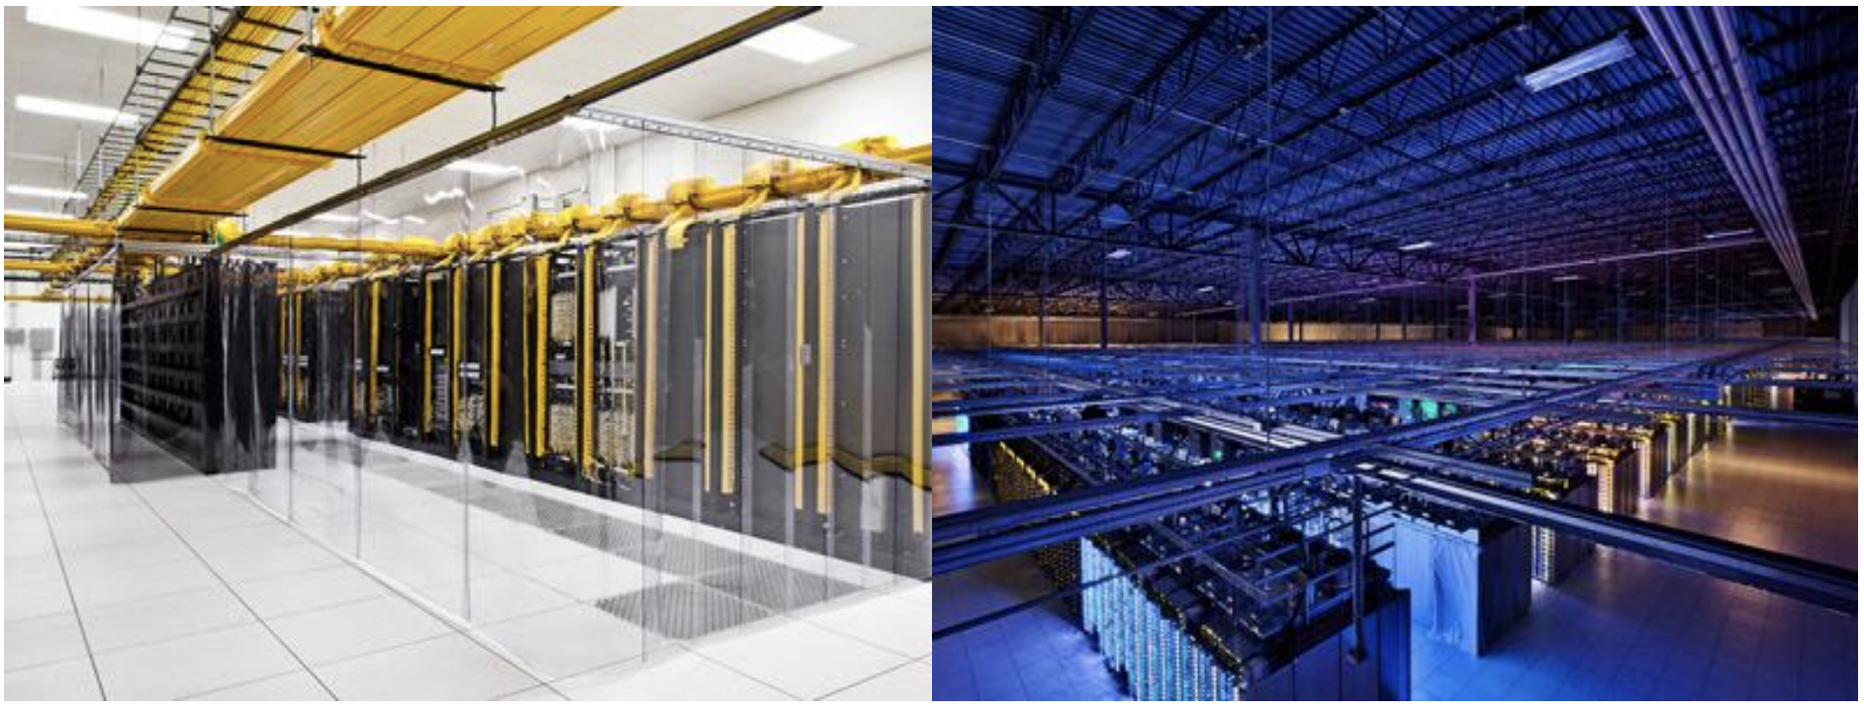
Google data center pictures: Council Bluffs

Slide 22
Анхаарал хандуулсанд баярлалаа

